Slide 1
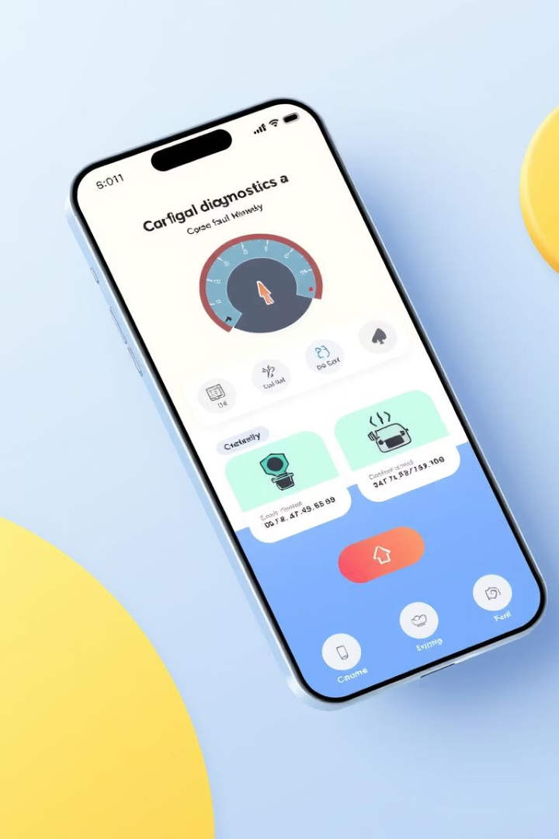
Car Fault Diagnostics App: Software Requirement Specification
This presentation outlines the software requirements for the Car Fault Diagnostic App.
It guides developers, testers, and stakeholders through the app's purpose, features, and validations.
By Group 21

Slide 2
01
Introduction and Purpose
Purpose
Scope
Assist vehicle owners and mechanics in diagnosing car faults via OBD-II connection.
Real-time fault detection, explanations, repair guidance, and maintenance reminders.
Users
Car owners, mechanics, and app administrators.

Slide 3
02
Problem Statement and Proposed Solution
Problem
Solution
Car owners struggle to interpret warning signs.
Scan dashboard lights and analyze engine sounds.
High repair costs due to lack of accessible tools.
Provide repair tutorials and maintenance reminders.
Existing apps lack offline and multilingual support.
Locate nearby mechanics and work offline.

Slide 4

03
Technology Stack
Frontend
Flutter (Dart) for cross-platform UI
Backend
Firebase for authentication and real-time data
Machine Learning
TensorFlow Lite and PyTorch for sound and image recognition
Database
Firestore and local storage (Hive/SQFlite)
Geolocation
Google Maps API and Flutter Geolocator

Slide 5

04
User Classes and Needs
Car Owners
Mechanics
Non-technical users needing simple, offline-friendly interfaces.
Garage owners seeking diagnostic validation and remote support.
App Administrators
Manage content, update models, and ensure multilingual support.

Slide 6
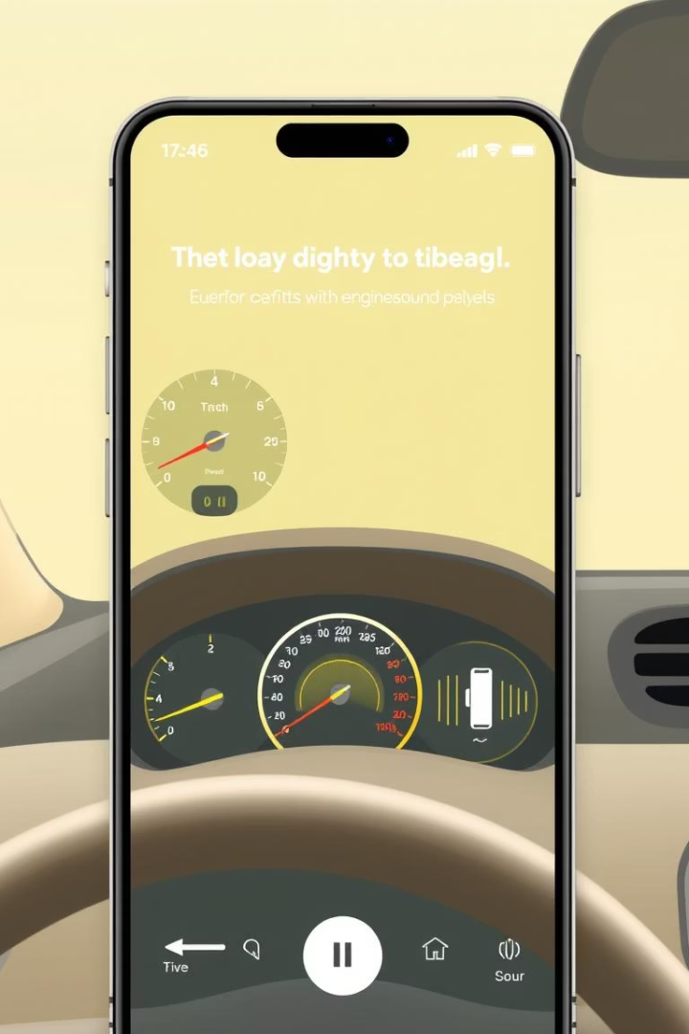




05
Functional Requirements Overview
User Authentication
Secure login with role-based access.
Dashboard Light Recognition
Camera scans and identifies warning lights.
Engine Sound Analysis
Microphone records and classifies engine noises.
Repair Guidance
Explanations, videos, and tutorials provided.

Slide 7
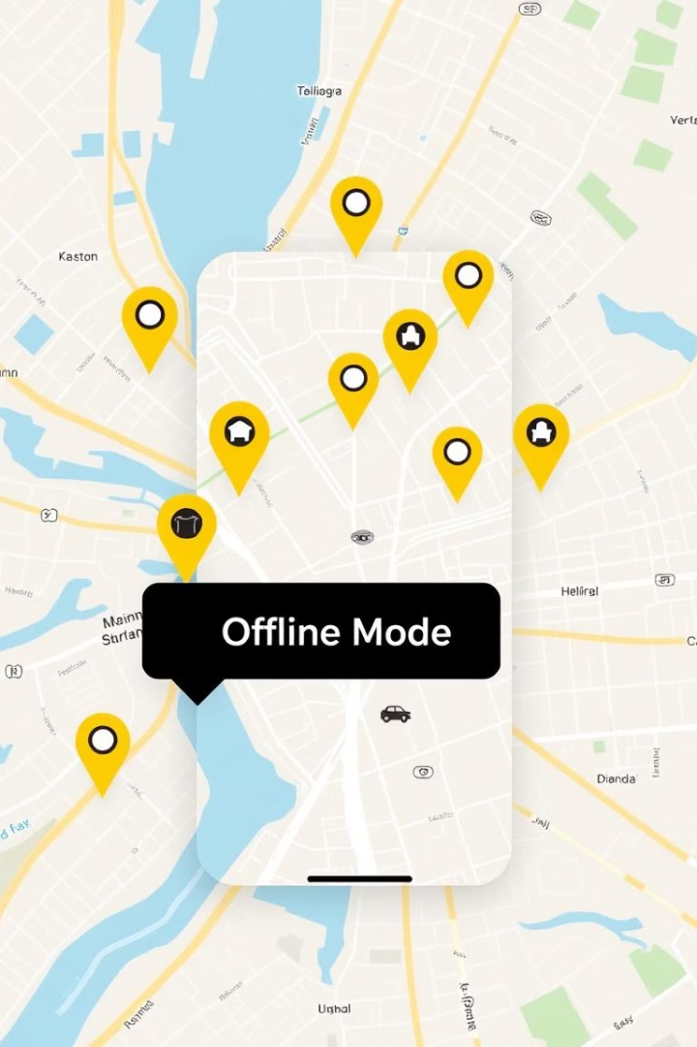
06
Additional Functional Features
Maintenance Logs & Reminders
Track service history and notify users.
Expert Advice & Mechanic Locator
Find nearby garages using GPS and contact experts.
Offline Functionality
Access tutorials and history without internet.
Multilingual Support
English, French, and local languages supported.

Slide 8

07
Non-Functional Requirements
Performance
App responds within 2 seconds for scans.
Privacy & Security
On-device processing and data encryption.
Usability & Accessibility
Simple UI, walkthroughs, screen reader support.
Scalability & Reliability
Supports 10,000+ users with 95% recognition accuracy.

Slide 9
08
Verification and Validation Highlights
Functional Analysis
Non-Functional Analysis
All requirements complete and feasible.
Performance, usability, and security verified.
Sound and offline features strongly validated.
Requirements testable with clear benchmarks.

Slide 10

09
Key Use Cases
Connect to Vehicle
Bluetooth/Wi-Fi connection to OBD-II adapter.
Dashboard Light Scanning
Camera identifies warning lights and suggests actions.
Engine Sound Analysis
Records and classifies engine noises for faults.
Offline Repair Guidance
Access instructions without internet in rural areas.

Slide 11
10
Technical Feasibility
Feature | Feasibility | Challenges
Dashboard Scanning | High | OBD-II integration
Sound Recognition | Medium | Noise filtering, ML accuracy
Offline Functionality | High | Local storage limits

Slide 12
11
Conclusion
App Goals: Reduce repair costs, empower users, integrate mechanics.
Key Strengths: Offline support, multilingual UI, ML-driven diagnostics.
Next Steps: Development, testing, and deployment.

